Slide 1

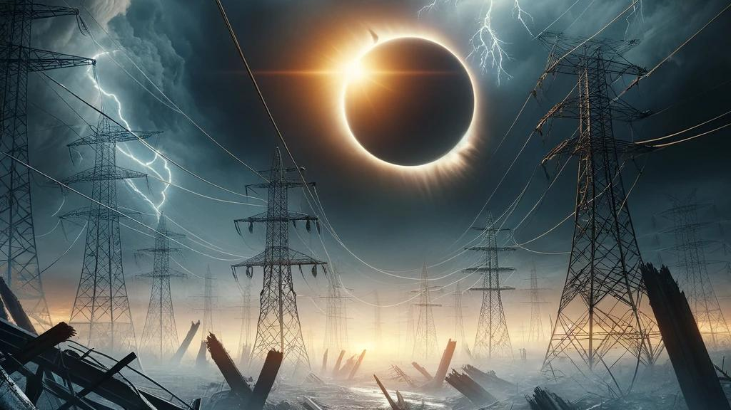
The Judgement Day of YHVH

Slide 2
The Day of the Lord

Slide 3
THE DAY OF THE LORD
Acts 2:17-21
(ASV, American Standard Version)
And it shall be in the last days, saith God, I will pour forth of my Spirit upon all flesh: And your sons and your daughters shall prophesy, And your young men shall see visions, And your old men shall dream dreams: Yea and on my servants and on my handmaidens in those days Will I pour forth of my Spirit; and they shall prophesy. And I will show wonders in the heaven above, And signs on the earth beneath; Blood, and fire, and vapor of smoke: (Continued...)

Slide 4
THE DAY OF THE LORD
The sun shall be turned into darkness, And the moon into blood, Before the day of the Lord come, That great and notable day. And it shall be, that whosoever shall call on the name of the Lord shall be saved.

Slide 5
THE DAY OF THE LORD
First Enoch 62:13-16
(RHCV, R.H. Charles Version)
And the righteous and elect shall be saved on that day, And the Lord of Spirits will abide over them, And the righteous and elect shall have risen from the earth, And these shall be the garments of life from the Lord of Spirits:

Slide 6
THE DAY OF THE LORD
First Peter 4:13
(ASV, American Standard Version)
but insomuch as ye are partakers of Christ's sufferings, rejoice; that at the revelation of his glory also ye may rejoice with exceeding joy.

Slide 7
THE DAY OF THE LORD
First Thessalonians 5:2-3
(NASB, New American Standard Bible)
For you yourselves know full well that the day of the Lord will come just like a thief in the night. While they are saying, "Peace and safety!" then destruction will come upon them suddenly like labor pains upon a woman with child, and they will not escape.

Slide 8
THE DAY OF THE LORD
Isaiah 30:26
(NASB, New American Standard Bible)
The light of the moon will be as the light of the sun, and the light of the sun will be seven times brighter, like the light of seven days, on the day the LORD binds up the fracture of His people and heals the bruise He has inflicted.

Slide 9
THE DAY OF THE LORD
James 5:5-9
(ASV, American Standard Version)
Ye have lived delicately on the earth, and taken your pleasure; ye have nourished your hearts in a day of slaughter. Ye have condemned, ye have killed the righteous one; he doth not resist you. Be patient therefore, brethren, until the coming of the Lord. Behold, the husbandman waiteth for the precious fruit of the earth, being patient over it, until it receive the early and latter rain. Be ye also patient; establish your hearts: for the coming of the Lord is at hand. (Continued...)

Slide 10
THE DAY OF THE LORD
Murmur not, brethren, one against another, that ye be not judged: behold, the judge standeth before the doors.

Slide 11
THE DAY OF THE LORD
Joel 2:31-32
(NASB, New American Standard Bible)
"The sun will be turned into darkness And the moon into blood Before the great and awesome day of the LORD comes. "And it will come about that whoever calls on the name of the LORD Will be delivered; For on Mount Zion and in Jerusalem There will be those who escape, As the LORD has said, Even among the survivors whom the LORD calls.

Slide 12
THE DAY OF THE LORD
Malachi 4:1-2
(NASB, New American Standard Bible)
"For behold, the day is coming, burning like a furnace; and all the arrogant and every evildoer will be chaff; and the day that is coming will set them ablaze," says the LORD of hosts, "so that it will leave them neither root nor branch." "But for you who fear My name, the sun of righteousness will rise with healing in its wings; and you will go forth and skip about like calves from the stall.

Slide 13
THE DAY OF THE LORD
Revelation 6:17
(NASB, New American Standard Bible)
for the great day of their wrath has come, and who is able to stand?"

Slide 14
THE DAY OF THE LORD
Second Peter 3:10
(NASB, New American Standard Bible)
But the day of the Lord will come like a thief, in which the heavens will pass away with a roar and the elements will be destroyed with intense heat, and the earth and its works will be burned up.

Slide 15
THE DAY OF THE LORD
Second Thessalonians 2:1-4
(ASV, American Standard Version)
Now we beseech you, brethren, touching the coming of our Lord Jesus Christ, and our gathering together unto him; to the end that ye be not quickly shaken from your mind, nor yet be troubled, either by spirit, or by word, or by epistle as from us, as that the day of the Lord is just at hand; let no man beguile you in any wise: (Continued...)

Slide 16
THE DAY OF THE LORD
for it will not be, except the falling away come first, and the man of sin be revealed, the son of perdition, he that opposeth and exalteth himself against all that is called God or that is worshipped; so that he sitteth in the temple of God, setting himself forth as God.

Slide 17
THE DAY OF THE LORD
Zephaniah 1:14-18
(NASB, New American Standard Bible)
Near is the great day of the LORD, Near and coming very quickly; Listen, the day of the LORD! In it the warrior cries out bitterly. A day of wrath is that day, A day of trouble and distress, A day of destruction and desolation, A day of darkness and gloom, A day of clouds and thick darkness, A day of trumpet and battle cry Against the fortified cities And the high corner towers. (Continued...)

Slide 18
THE DAY OF THE LORD
I will bring distress on men So that they will walk like the blind, Because they have sinned against the LORD; And their blood will be poured out like dust And their flesh like dung. Neither their silver nor their gold Will be able to deliver them On the day of the LORD'S wrath; And all the earth will be devoured In the fire of His jealousy, For He will make a complete end, Indeed a terrifying one, Of all the inhabitants of the earth.

Slide 19
THE DAY OF THE LORD
Assumption of Moses 1:16-18
(RHCV, R.H. Charles Version)
And receive thou this writing that thou mayst know how to preserve the books which I shall deliver unto thee: And thou shalt set these in order and anoint them with oil of cedar and put them away in earthen vessels in the place which He made from the beginning of the creation of the world, That His name should be called upon until the day of repentance in the visitation wherewith the Lord shall visit them in the consummation of the end of the days.

Slide 20
THE DAY OF THE LORD
Jubilees 36:10
(RHCV, R.H. Charles Version)
But on the day of turbulence and execration and indignation and anger, with flaming devouring fire as He burnt Sodom, so likewise will He burn his land and his city and all that is his, and he shall be blotted out of the book of the discipline of the children of men, and not be recorded in the book of life, but in that which is appointed to destruction, and he shall depart into eternal execration; (Continued...)

Slide 21
THE DAY OF THE LORD
so that their condemnation may be always renewed in hate and in execration and in wrath and in torment and in indignation and in plagues and in disease for ever.

Slide 22
The Return of Yeshua

Slide 23
THE RETURN OF YESHUA
First Samuel 2:10
(NASB, New American Standard Bible)
"Those who contend with the LORD will be shattered; Against them He will thunder in the heavens, The LORD will judge the ends of the earth; And He will give strength to His king, And will exalt the horn of His anointed."

Slide 24
THE RETURN OF YESHUA
First Thessalonians 4:16-17
(NASB, New American Standard Bible)
For the Lord Himself will descend from heaven with a shout, with the voice of the archangel and with the trumpet of God, and the dead in Christ will rise first. Then we who are alive and remain will be caught up together with them in the clouds to meet the Lord in the air, and so we shall always be with the Lord.

Slide 25
THE RETURN OF YESHUA
John 16:16
(ASV, American Standard Version)
A little while, and ye behold me no more; and again a little while, and ye shall see me.

Slide 26
THE RETURN OF YESHUA
Jude 1:14
(ASV, American Standard Version)
And to these also Enoch, the seventh from Adam, prophesied, saying, Behold, the Lord came with ten thousands of his holy ones,

Slide 27
THE RETURN OF YESHUA
Matthew 16:27
(NASB, New American Standard Bible)
"For the Son of Man is going to come in the glory of His Father with His angels, and WILL THEN REPAY EVERY MAN ACCORDING TO HIS DEEDS.

Slide 28
THE RETURN OF YESHUA
Matthew 24:30-31
(NASB, New American Standard Bible)
"And then the sign of the Son of Man will appear in the sky, and then all the tribes of the earth will mourn, and they will see the SON OF MAN COMING ON THE CLOUDS OF THE SKY with power and great glory. "And He will send forth His angels with A GREAT TRUMPET and THEY WILL GATHER TOGETHER His elect from the four winds, from one end of the sky to the other.

Slide 29
THE RETURN OF YESHUA
Revelation 1:7
(NASB, New American Standard Bible)
BEHOLD, HE IS COMING WITH THE CLOUDS, and every eye will see Him, even those who pierced Him; and all the tribes of the earth will mourn over Him. So it is to be. Amen.

Slide 30
THE RETURN OF YESHUA
Revelation 19:11-16
(NASB, New American Standard Bible)
And I saw heaven opened, and behold, a white horse, and He who sat on it is called Faithful and True, and in righteousness He judges and wages war. His eyes are a flame of fire, and on His head are many diadems; and He has a name written on Him which no one knows except Himself. He is clothed with a robe dipped in blood, and His name is called The Word of God. And the armies which are in heaven, clothed in fine linen, white and clean, were following Him on white horses. (Continued...)

Slide 31
THE RETURN OF YESHUA
From His mouth comes a sharp sword, so that with it He may strike down the nations, and He will rule them with a rod of iron; and He treads the wine press of the fierce wrath of God, the Almighty. And on His robe and on His thigh He has a name written, "KING OF KINGS, AND LORD OF LORDS."

Slide 32
THE RETURN OF YESHUA
Second Thessalonians 1:7-10
(NASB, New American Standard Bible)
and to give relief to you who are afflicted and to us as well when the Lord Jesus will be revealed from heaven with His mighty angels in flaming fire, dealing out retribution to those who do not know God and to those who do not obey the gospel of our Lord Jesus. (Continued...)

Slide 33
THE RETURN OF YESHUA
These will pay the penalty of eternal destruction, away from the presence of the Lord and from the glory of His power, when He comes to be glorified in His saints on that day, and to be marveled at among all who have believed--for our testimony to you was believed.

Slide 34
THE RETURN OF YESHUA
Acts 1:11
(NASB, New American Standard Bible)
They also said, "Men of Galilee, why do you stand looking into the sky? This Jesus, who has been taken up from you into heaven, will come in just the same way as you have watched Him go into heaven."

Slide 35
The Judgment

Slide 36
THE JUDGMENT
First Enoch 27:1-5
(RHCV, R.H. Charles Version)
Then said I: 'For what object is this blessed land, which is entirely filled with trees, and this accursed valley between?' Then Uriel, one of the holy angels who was with me, answered and said: 'This accursed valley is for those who are accursed for ever: Here shall all the accursed be gathered together who utter with their lips against the Lord unseemly words and of His glory speak hard things. (Continued...)

Slide 37
THE JUDGMENT
Here shall they be gathered together, and here shall be their place of judgement. In the last days there shall be upon them the spectacle of righteous judgement in the presence of the righteous for ever: here shall the merciful bless the Lord of glory, the Eternal King. In the days of judgement over the former, they shall bless Him for the mercy in accordance with which He has assigned them (their lot). (Continued...)

Slide 38
THE JUDGMENT
' Then I blessed the Lord of Glory and set forth His glory and lauded Him gloriously.

Slide 39
THE JUDGMENT
First Enoch 98:7-8
(RHCV, R.H. Charles Version)
And do not think in your spirit nor say in your heart that ye do not know and that ye do not see that every sin is every day recorded in heaven in the presence of the Most High. From henceforth ye know that all your oppression wherewith ye oppress is written down every day till the day of your judgement.

Slide 40
THE JUDGMENT
First Enoch 97:1-6
(RHCV, R.H. Charles Version)
Believe, ye righteous, that the sinners will become a shame Be it known unto you (ye sinners) that the Most High is mindful of your destruction, What will ye do, ye sinners, Yea, ye shall fare like unto them, And in those days the prayer of the righteous shall reach unto the Lord, And all the words of your unrighteousness shall be read out before the Great Holy One,

Slide 41
THE JUDGMENT
First Peter 4:17
(NASB, New American Standard Bible)
For it is time for judgment to begin with the household of God; and if it begins with us first, what will be the outcome for those who do not obey the gospel of God?

Slide 42
THE JUDGMENT
Hebrews 10:30-31
(ASV, American Standard Version)
For we know him that said, Vengeance belongeth unto me, I will recompense. And again, The Lord shall judge his people. It is a fearful thing to fall into the hands of the living God.

Slide 43
THE JUDGMENT
John 5:28-29
(NASB, New American Standard Bible)
"Do not marvel at this; for an hour is coming, in which all who are in the tombs will hear His voice, and will come forth; those who did the good deeds to a resurrection of life, those who committed the evil deeds to a resurrection of judgment.

Slide 44
THE JUDGMENT
Luke 3:17
(ASV, American Standard Version)
whose fan is in his hand, thoroughly to cleanse his threshing-floor, and to gather the wheat into his garner; but the chaff he will burn up with unquenchable fire.

Slide 45
THE JUDGMENT
Matthew 12:36-37
(NASB, New American Standard Bible)
"But I tell you that every careless word that people speak, they shall give an accounting for it in the day of judgment. "For by your words you will be justified, and by your words you will be condemned."

Slide 46
THE JUDGMENT
Psalm 98:8-9
(NASB, New American Standard Bible)
Let the rivers clap their hands, Let the mountains sing together for joy Before the LORD, for He is coming to judge the earth; He will judge the world with righteousness And the peoples with equity.

Slide 47
THE JUDGMENT
Revelation 20:11-12
(NASB, New American Standard Bible)
Then I saw a great white throne and Him who sat upon it, from whose presence earth and heaven fled away, and no place was found for them. And I saw the dead, the great and the small, standing before the throne, and books were opened; and another book was opened, which is the book of life; and the dead were judged from the things which were written in the books, according to their deeds.

Slide 48
THE JUDGMENT
Romans 2:12-16
(NASB, New American Standard Bible)
For all who have sinned without the Law will also perish without the Law, and all who have sinned under the Law will be judged by the Law; for it is not the hearers of the Law who are just before God, but the doers of the Law will be justified. (Continued...)

Slide 49
THE JUDGMENT
For when Gentiles who do not have the Law do instinctively the things of the Law, these, not having the Law, are a law to themselves, in that they show the work of the Law written in their hearts, their conscience bearing witness and their thoughts alternately accusing or else defending them, on the day when, according to my gospel, God will judge the secrets of men through Christ Jesus.

Slide 50
THE JUDGMENT
Second Corinthians 5:10
(NASB, New American Standard Bible)
For we must all appear before the judgment seat of Christ, so that each one may be recompensed for his deeds in the body, according to what he has done, whether good or bad.

Slide 51
THE JUDGMENT
Second Peter 3:10-12
(ASV, American Standard Version)
But the day of the Lord will come as a thief; in the which the heavens shall pass away with a great noise, and the elements shall be dissolved with fervent heat, and the earth and the works that are therein shall be burned up. (Continued...)

Slide 52
THE JUDGMENT
Seeing that these things are thus all to be dissolved, what manner of persons ought ye to be in all holy living and godliness, looking for and earnestly desiring the coming of the day of God, by reason of which the heavens being on fire shall be dissolved, and the elements shall melt with fervent heat?

Slide 53
THE JUDGMENT
Shepherd of Hermas 10:1-2
(JBLT, J. B. Lightfoot Translation)
"What did they suffer?" say I. "Listen," saith she. "Stripes, imprisonments, great tribulations, crosses, wild beasts, for the Name's sake. Therefore to them belongs the right side of the Holiness--to them, and to all who shall suffer for the Name. But for the rest is the left side. Howbeit, to both, to them that sit on the right, and to them that sit on the left, are the same gifts, and the same promises, only they sit on the right and have a certain glory. (Continued...)

Slide 54
THE JUDGMENT
Thou indeed art very desirous to sit on the right with them, but thy shortcomings are many; yet thou shalt be purified from thy shortcomings; yea, and all that are not double-minded shall be purified from all their sins unto this day."

Slide 55
Survivors

Slide 56
SURVIVORS
Joel 2:32
(NASB, New American Standard Bible)
"And it will come about that whoever calls on the name of the LORD Will be delivered; For on Mount Zion and in Jerusalem There will be those who escape, As the LORD has said, Even among the survivors whom the LORD calls.

