Slide 1
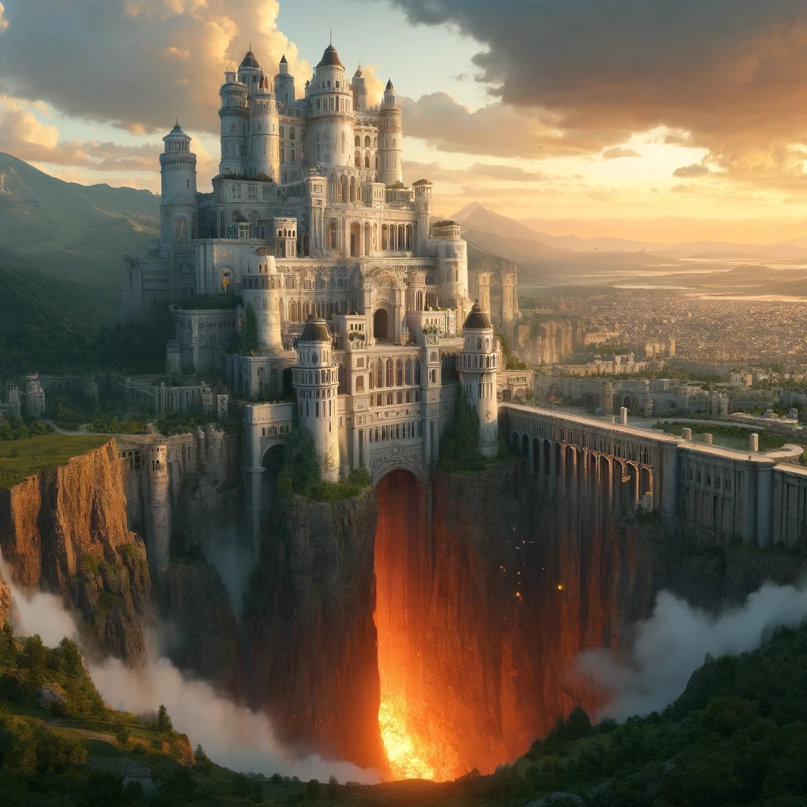
The Lake of Fire

Slide 2
Located in Zion

Slide 3
LOCATED IN ZION
First Enoch 90:20
(RHCV, R.H. Charles Version)
And I saw at that time how a like abyss was opened in the midst of the earth, full of fire, and they brought those blinded sheep, and they were all judged and found guilty and cast into this fiery abyss, and they burned; now this abyss was to the right of that house.

Slide 4
A lake consisting of fire

Slide 5
A LAKE CONSISTING OF FIRE
First Enoch 108:3
(RHCV, R.H. Charles Version)
And wait ye indeed till sin has passed away, for their names shall be blotted out of the book of life and out of the holy books, and their seed shall be destroyed for ever, and their spirits shall be slain, and they shall cry and make lamentation in a place that is a chaotic wilderness, and in the fire shall they burn; for there is no earth there.

Slide 6
A LAKE CONSISTING OF FIRE
First Enoch 108:3-6
(RHCV, R.H. Charles Version)
And wait ye indeed till sin has passed away, for their names shall be blotted out of the book of life and out of the holy books, and their seed shall be destroyed for ever, and their spirits shall be slain, and they shall cry and make lamentation in a place that is a chaotic wilderness, and in the fire shall they burn; for there is no earth there. And I saw there something like an invisible cloud; (Continued...)

Slide 7
A LAKE CONSISTING OF FIRE
for by reason of its depth I could not look over, and I saw a flame of fire blazing brightly, and things like shining mountains circling and sweeping to and fro. And I asked one of the holy angels who was with me and said unto him: ' What is this shining thing? for it is not a heaven but only the flame of a blazing fire, and the voice of weeping and crying and lamentation and strong pain.' And he said unto me: (Continued...)

Slide 8
A LAKE CONSISTING OF FIRE
' This place which thou seest-here are cast the spirits of sinners and blasphemers, and of those who work wickedness, and of those who pervert everything that the Lord hath spoken through the mouth

Slide 9
A LAKE CONSISTING OF FIRE
Revelation 19:20
(NASB, New American Standard Bible)
And the beast was seized, and with him the false prophet who performed the signs in his presence, by which he deceived those who had received the mark of the beast and those who worshiped his image; these two were thrown alive into the lake of fire which burns with brimstone.

Slide 10
A LAKE CONSISTING OF FIRE
Revelation 20:10-15
(NASB, New American Standard Bible)
And the devil who deceived them was thrown into the lake of fire and brimstone, where the beast and the false prophet are also; and they will be tormented day and night forever and ever. Then I saw a great white throne and Him who sat upon it, from whose presence earth and heaven fled away, and no place was found for them. And I saw the dead, the great and the small, standing before the throne, and books were opened; and another book was opened, which is the book of life; (Continued...)

Slide 11
A LAKE CONSISTING OF FIRE
and the dead were judged from the things which were written in the books, according to their deeds. And the sea gave up the dead which were in it, and death and Hades gave up the dead which were in them; and they were judged, every one of them according to their deeds. Then death and Hades were thrown into the lake of fire. This is the second death, the lake of fire. And if anyone's name was not found written in the book of life, he was thrown into the lake of fire.

Slide 12
Where things go to be destroyed forever

Slide 13
Burning Forever?

Slide 14
Burning Forever?
First Enoch 108:3-6
(RHCV, R.H. Charles Version)
And wait ye indeed till sin has passed away, for their names shall be blotted out of the book of life and out of the holy books, and their seed shall be destroyed for ever, and their spirits shall be slain, and they shall cry and make lamentation in a place that is a chaotic wilderness, and in the fire shall they burn; for there is no earth there. And I saw there something like an invisible cloud; (Continued...)

Slide 15
Burning Forever?
for by reason of its depth I could not look over, and I saw a flame of fire blazing brightly, and things like shining mountains circling and sweeping to and fro. And I asked one of the holy angels who was with me and said unto him: ' What is this shining thing? for it is not a heaven but only the flame of a blazing fire, and the voice of weeping and crying and lamentation and strong pain.' And he said unto me: (Continued...)

Slide 16
Burning Forever?
' This place which thou seest-here are cast the spirits of sinners and blasphemers, and of those who work wickedness, and of those who pervert everything that the Lord hath spoken through the mouth

Slide 17
Burning Forever?
First Enoch 67:13
(RHCV, R.H. Charles Version)
earth.' Because these waters of judgement minister to the healing of the body of the kings and the lust of their body; therefore they will not see and will not believe that those waters will change and become a fire which burns for ever.

Slide 18
Burning Forever?
Matthew 25:45-46
(NASB, New American Standard Bible)
"Then He will answer them, 'Truly I say to you, to the extent that you did not do it to one of the least of these, you did not do it to Me.' "These will go away into eternal punishment, but the righteous into eternal life."

Slide 19
Burning Forever?
Revelation 20:10
(NASB, New American Standard Bible)
And the devil who deceived them was thrown into the lake of fire and brimstone, where the beast and the false prophet are also; and they will be tormented day and night forever and ever.

Slide 20
Burning Forever?
Assumption of Moses 10:9
(RHCV, R.H. Charles Version)
And God will exalt thee, And He will cause thee to approach to the heaven of the stars, And He will establish thy habitation among them. 10.And thou wilt look from on high and wilt see thy enemies in Ge(henna), And thou wilt recognize them and rejoice, And thou wilt give thanks and confess thy Creator.

Slide 21
Burning Forever?
First Enoch 10:12-13
(RHCV, R.H. Charles Version)
with them in all their uncleanness. And when their sons have slain one another, and they have seen the destruction of their beloved ones, bind them fast for seventy generations in the valleys of the earth, till the day of their judgement and of their consummation, till the judgement that is for ever and ever is consummated. In those days they shall be led off to the abyss of fire: and

Slide 22
Burning Forever?
First Enoch 54:1-5
(RHCV, R.H. Charles Version)
And I looked and turned to another part of the earth, and saw there a deep valley with burning fire. And they brought the kings and the mighty, and began to cast them into this deep valley. And there mine eyes saw how they made these their instruments, iron chains of immeasurable weight. And I asked the angel of peace who went with me, saying: ' For whom are these chains being prepared ? ' And he said unto me: (Continued...)

Slide 23
Burning Forever?
' These are being prepared for the hosts of Azazel, so that they may take them and cast them into the abyss of complete condemnation, and they shall cover their jaws with rough stones as the Lord of Spirits commanded.

Slide 24
Burning Forever?
First Enoch 90:19-21
(RHCV, R.H. Charles Version)
And those seventy shepherds were judged and found guilty, and they were cast into that fiery abyss. And I saw at that time how a like abyss was opened in the midst of the earth, full of fire, and they brought those blinded sheep, and they were all judged and found guilty and cast into this fiery abyss, and they burned; now this abyss was to the right of that house. And I saw those sheep burning and their bones burning.

Slide 25
Burning Forever?
Testament of Kohath [4Q542, Fragment 2] 1:1
(RHCVKJ, R.H. Charles Translation, Edited by Ken Johnson, Th.D.)
... from your judgment... you will rise to make judgment on... to see the sins of all the sinners of the world... In the fire, in the abyss and in the caverns in order to... In the time of justice and all the wicked will vanish.

Slide 26
Burning Forever?
Matthew 10:28
(NASB, New American Standard Bible)
"Do not fear those who kill the body but are unable to kill the soul; but rather fear Him who is able to destroy both soul and body in hell.

