Slide 1
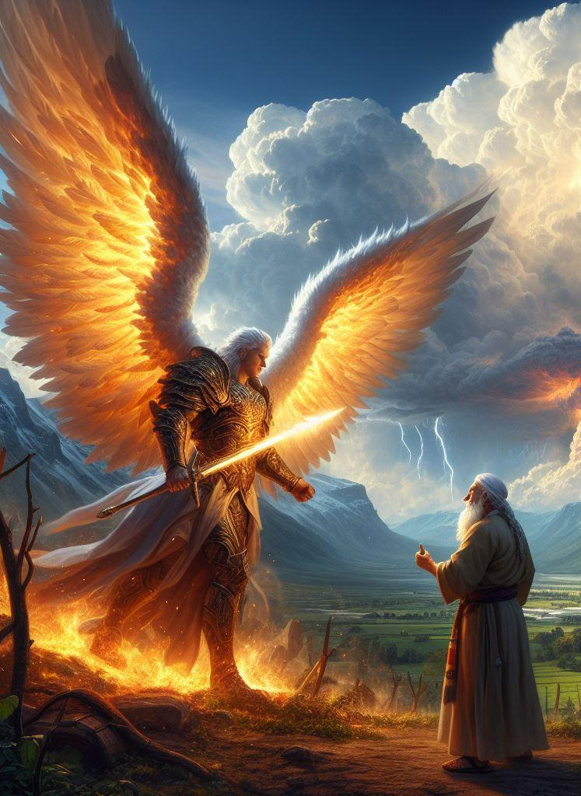
Messengers of YHVH
(Agency)

Slide 2
YHVH's Messengers appearing as YHVH himself

Slide 3
Uriel, acting on behalf of YHVH, sends a message to Noah

Slide 4
Uriel, acting on behalf of YHVH, sends a message to Noah
First Enoch 10:1-3
(RHCV, R.H. Charles Version)
Then said the Most High, the Holy and Great One spake, and sent Uriel to the son of Lamech, and said to him: 'Go to Noah and tell him in my name "Hide thyself!" and reveal to him the end that is approaching: that the whole earth will be destroyed, and a deluge is about to come upon the whole earth, and will destroy all that is on it. And now instruct him that he may escape

Slide 5
Uriel, acting on behalf of YHVH, sends a message to Noah
Genesis 6:13
(NASB, New American Standard Bible)
Then God said to Noah, "The end of all flesh has come before Me; for the earth is filled with violence because of them; and behold, I am about to destroy them with the earth.

Slide 6
Prophets, acting on behalf of YHVH, sends a message to the people

Slide 7
Prophets, acting on behalf of YHVH, sends a message to the people
Exodus 3:13-15
(NASB, New American Standard Bible)
Then Moses said to God, "Behold, I am going to the sons of Israel, and I will say to them, 'The God of your fathers has sent me to you.' Now they may say to me, 'What is His name?' What shall I say to them?" God said to Moses, "I AM WHO I AM"; and He said, "Thus you shall say to the sons of Israel, 'I AM has sent me to you. (Continued...)

Slide 8
Prophets, acting on behalf of YHVH, sends a message to the people
'" God, furthermore, said to Moses, "Thus you shall say to the sons of Israel, 'The LORD, the God of your fathers, the God of Abraham, the God of Isaac, and the God of Jacob, has sent me to you.' This is My name forever, and this is My memorial-name to all generations.

Slide 9
Prophets, acting on behalf of YHVH, sends a message to the people
Second Chronicles 36:15-16
(NASB, New American Standard Bible)
The LORD, the God of their fathers, sent word to them again and again by His messengers, because He had compassion on His people and on His dwelling place; but they continually mocked the messengers of God, despised His words and scoffed at His prophets, until the wrath of the LORD arose against His people, until there was no remedy.

Slide 10
Men, acting on behalf of YHVH, save the people of Israel

Slide 11
Men, acting on behalf of YHVH, save the people of Israel
Acts 7:35
(ESV, English Standard Version)
"This Moses, whom they rejected, saying, 'Who made you a ruler and a judge?'-this man God sent as both ruler and redeemer by the hand of the angel who appeared to him in the bush.

Slide 12
Men, acting on behalf of YHVH, save the people of Israel
Judges 2:16
(NASB, New American Standard Bible)
Then the LORD raised up judges who delivered them from the hands of those who plundered them.

Slide 13
Men, acting on behalf of YHVH, save the people of Israel
Judges 3:15
(NASB, New American Standard Bible)
But when the sons of Israel cried to the LORD, the LORD raised up a deliverer for them, Ehud the son of Gera, the Benjamite, a left-handed man. And the sons of Israel sent tribute by him to Eglon the king of Moab.

Slide 14
Men, acting on behalf of YHVH, save the people of Israel
Judges 3:9
(NASB, New American Standard Bible)
When the sons of Israel cried to the LORD, the LORD raised up a deliverer for the sons of Israel to deliver them, Othniel the son of Kenaz, Caleb's younger brother.

Slide 15
Men, acting on behalf of YHVH, save the people of Israel
Nehemiah 9:27
(NASB, New American Standard Bible)
"Therefore You delivered them into the hand of their oppressors who oppressed them, But when they cried to You in the time of their distress, You heard from heaven, and according to Your great compassion You gave them deliverers who delivered them from the hand of their oppressors.

Slide 16
Men, acting on behalf of YHVH, save the people of Israel
Isaiah 43:11
(NASB, New American Standard Bible)
"I, even I, am the LORD, And there is no savior besides Me.

Slide 17
Yeshua, acting on behalf of YHVH, save the people of Israel

Slide 18
Yeshua, acting on behalf of YHVH, save the people of Israel
First John 4:14
(NASB, New American Standard Bible)
We have seen and testify that the Father has sent the Son to be the Savior of the world.

Slide 19
Yeshua, acting on behalf of YHVH, save the people of Israel
John 12:49-50
(ASV, American Standard Version)
For I spake not from myself; but the Father that sent me, he hath given me a commandment, what I should say, and what I should speak. And I know that his commandment is life eternal: the things therefore which I speak, even as the Father hath said unto me, so I speak.

Slide 20
Yeshua, acting on behalf of YHVH, save the people of Israel
Revelation 19:15
(ASV, American Standard Version)
And out of his mouth proceedeth a sharp sword, that with it he should smite the nations: and he shall rule them with a rod of iron: and he treadeth the winepress of the fierceness of the wrath of God, the Almighty.

Slide 21
Angels acting on behalf of YHVH

Slide 22
Angels acting on behalf of YHVH
Revelation 22:6
(ASV, American Standard Version)
And he said unto me, These words are faithful and true: and the Lord, the God of the spirits of the prophets, sent his angel to show unto his servants the things which must shortly come to pass.

Slide 23
Angels acting on behalf of YHVH
Luke 2:15
(NASB, New American Standard Bible)
When the angels had gone away from them into heaven, the shepherds began saying to one another, "Let us go straight to Bethlehem then, and see this thing that has happened which the Lord has made known to us."

Slide 24
Angels acting on behalf of YHVH
Acts 12:11
(NASB, New American Standard Bible)
When Peter came to himself, he said, "Now I know for sure that the Lord has sent forth His angel and rescued me from the hand of Herod and from all that the Jewish people were expecting."

Slide 25
The Angel of YHVH, acting on behalf of YHVH, leads the people of Israel through Sinai

Slide 26
The Angel of YHVH, acting on behalf of YHVH, leads the people of Israel through Sinai
Acts 7:38
(NASB, New American Standard Bible)
"This is the one who was in the congregation in the wilderness together with the angel who was speaking to him on Mount Sinai, and who was with our fathers; and he received living oracles to pass on to you.

Slide 27
The Angel of YHVH, acting on behalf of YHVH, leads the people of Israel through Sinai
Acts 7:51-53
(NASB, New American Standard Bible)
"You men who are stiff-necked and uncircumcised in heart and ears are always resisting the Holy Spirit; you are doing just as your fathers did. "Which one of the prophets did your fathers not persecute? They killed those who had previously announced the coming of the Righteous One, whose betrayers and murderers you have now become; you who received the law as ordained by angels, and yet did not keep it."

Slide 28
The Angel of YHVH, acting on behalf of YHVH, leads the people of Israel through Sinai
Exodus 16:10-11
(NASB, New American Standard Bible)
It came about as Aaron spoke to the whole congregation of the sons of Israel, that they looked toward the wilderness, and behold, the glory of the LORD appeared in the cloud. And the LORD spoke to Moses, saying,

Slide 29
The Angel of YHVH, acting on behalf of YHVH, leads the people of Israel through Sinai
Galatians 3:19
(NASB, New American Standard Bible)
Why the Law then? It was added because of transgressions, having been ordained through angels by the agency of a mediator, until the seed would come to whom the promise had been made.

Slide 30
The angel of the Lord, speaks on behalf of YHVH, from the burning bush

Slide 31
The angel of the Lord, speaks on behalf of YHVH, from the burning bush
Acts 7:29-38
(NASB, New American Standard Bible)
"At this remark, MOSES FLED AND BECAME AN ALIEN IN THE LAND OF MIDIAN, where he became the father of two sons. "After forty years had passed, AN ANGEL APPEARED TO HIM IN THE WILDERNESS OF MOUNT Sinai, IN THE FLAME OF A BURNING THORN BUSH. "When Moses saw it, he marveled at the sight; and as he approached to look more closely, there came the voice of the Lord: I AM THE GOD OF YOUR FATHERS, THE GOD OF ABRAHAM AND ISAAC AND JACOB. (Continued...)

Slide 32
The angel of the Lord, speaks on behalf of YHVH, from the burning bush
' Moses shook with fear and would not venture to look. "BUT THE LORD SAID TO HIM, 'TAKE OFF THE SANDALS FROM YOUR FEET, FOR THE PLACE ON WHICH YOU ARE STANDING IS HOLY GROUND. I HAVE CERTAINLY SEEN THE OPPRESSION OF MY PEOPLE IN EGYPT AND HAVE HEARD THEIR GROANS, AND I HAVE COME DOWN TO RESCUE THEM; COME NOW, AND I WILL SEND YOU TO EGYPT.' "This Moses whom they disowned, saying, 'WHO MADE YOU A RULER AND A JUDGE? (Continued...)

Slide 33
The angel of the Lord, speaks on behalf of YHVH, from the burning bush
' is the one whom God sent to be both a ruler and a deliverer with the help of the angel who appeared to him in the thorn bush. "This man led them out, performing wonders and signs in the land of Egypt and in the Red Sea and in the wilderness for forty years. "This is the Moses who said to the sons of Israel, 'GOD WILL RAISE UP FOR YOU A PROPHET LIKE ME FROM YOUR BRETHREN. (Continued...)

Slide 34
The angel of the Lord, speaks on behalf of YHVH, from the burning bush
' "This is the one who was in the congregation in the wilderness together with the angel who was speaking to him on Mount Sinai, and who was with our fathers; and he received living oracles to pass on to you.

Slide 35
The angel of the Lord, speaks on behalf of YHVH, from the burning bush
Exodus 3:1-6
(NASB, New American Standard Bible)
Now Moses was pasturing the flock of Jethro his father-in-law, the priest of Midian; and he led the flock to the west side of the wilderness and came to Horeb, the mountain of God. The angel of the LORD appeared to him in a blazing fire from the midst of a bush; and he looked, and behold, the bush was burning with fire, yet the bush was not consumed. So Moses said, "I must turn aside now and see this marvelous sight, why the bush is not burned up. (Continued...)

Slide 36
The angel of the Lord, speaks on behalf of YHVH, from the burning bush
" When the LORD saw that he turned aside to look, God called to him from the midst of the bush and said, "Moses, Moses!" And he said, "Here I am." Then He said, "Do not come near here; remove your sandals from your feet, for the place on which you are standing is holy ground." He said also, "I am the God of your father, the God of Abraham, the God of Isaac, and the God of Jacob." Then Moses hid his face, for he was afraid to look at God.

Slide 37
The angel of the Lord, speaks on behalf of YHVH, from the burning bush
Mark 12:26
(ASV, American Standard Version)
But as touching the dead, that they are raised; have ye not read in the book of Moses, in the place concerning the Bush, how God spake unto him, saying, I am the God of Abraham, and the God of Isaac, and the God of Jacob?

Slide 38
Yeshua is a messenger

Slide 39
Yeshua is a messenger
John 16:5
(NASB, New American Standard Bible)
"But now I am going to Him who sent Me; and none of you asks Me, 'Where are You going?'

Slide 40
Yeshua is a messenger
John 17:1-4
(NASB, New American Standard Bible)
Jesus spoke these things; and lifting up His eyes to heaven, He said, "Father, the hour has come; glorify Your Son, that the Son may glorify You, even as You gave Him authority over all flesh, that to all whom You have given Him, He may give eternal life. "This is eternal life, that they may know You, the only true God, and Jesus Christ whom You have sent. "I glorified You on the earth, having accomplished the work which You have given Me to do.

Slide 41
Yeshua is a messenger
John 17:18
(NASB, New American Standard Bible)
"As You sent Me into the world, I also have sent them into the world.

Slide 42
Yeshua is a messenger
John 17:25
(NASB, New American Standard Bible)
"O righteous Father, although the world has not known You, yet I have known You; and these have known that You sent Me;

Slide 43
Yeshua is a messenger
John 20:21
(NASB, New American Standard Bible)
So Jesus said to them again, "Peace be with you; as the Father has sent Me, I also send you."

Slide 44
Yeshua is a messenger
John 7:16
(NASB, New American Standard Bible)
So Jesus answered them and said, "My teaching is not Mine, but His who sent Me.

Slide 45
Yeshua is a messenger
John 7:33
(NASB, New American Standard Bible)
Therefore Jesus said, "For a little while longer I am with you, then I go to Him who sent Me.

Slide 46
Yeshua is a messenger
John 8:42
(NASB, New American Standard Bible)
Jesus said to them, "If God were your Father, you would love Me, for I proceeded forth and have come from God, for I have not even come on My own initiative, but He sent Me.

Slide 47
Yeshua is a messenger
Luke 10:16
(NASB, New American Standard Bible)
"The one who listens to you listens to Me, and the one who rejects you rejects Me; and he who rejects Me rejects the One who sent Me."

Slide 48
Yeshua is a messenger
Luke 20:9-16
(NASB, New American Standard Bible)
And He began to tell the people this parable: "A man planted a vineyard and rented it out to vine-growers, and went on a journey for a long time. "At the harvest time he sent a slave to the vine-growers, so that they would give him some of the produce of the vineyard; but the vine-growers beat him and sent him away empty-handed. "And he proceeded to send another slave; and they beat him also and treated him shamefully and sent him away empty-handed. (Continued...)

Slide 49
Yeshua is a messenger
"And he proceeded to send a third; and this one also they wounded and cast out. "The owner of the vineyard said, 'What shall I do? I will send my beloved son; perhaps they will respect him.' "But when the vine-growers saw him, they reasoned with one another, saying, 'This is the heir; let us kill him so that the inheritance will be ours.' "So they threw him out of the vineyard and killed him. What, then, will the owner of the vineyard do to them? (Continued...)

Slide 50
Yeshua is a messenger
"He will come and destroy these vine-growers and will give the vineyard to others." When they heard it, they said, "May it never be!"

Slide 51
Yeshua is a messenger
Malachi 3:1-2
(NASB, New American Standard Bible)
"Behold, I am going to send My messenger, and he will clear the way before Me. And the Lord, whom you seek, will suddenly come to His temple; and the messenger of the covenant, in whom you delight, behold, He is coming," says the LORD of hosts. "But who can endure the day of His coming? And who can stand when He appears? For He is like a refiner's fire and like fullers' soap.

Slide 52
Other Examples of Messengers

Slide 53
John the Baptist had messengers

Slide 54
John the Baptist had messengers
Luke 7:24
(NASB, New American Standard Bible)
When the messengers of John had left, He began to speak to the crowds about John, "What did you go out into the wilderness to see? A reed shaken by the wind?

Slide 55
Yeshua has messengers

Slide 56
Yeshua has messengers
Luke 9:51-52
(NASB, New American Standard Bible)
When the days were approaching for His ascension, He was determined to go to Jerusalem; and He sent messengers on ahead of Him, and they went and entered a village of the Samaritans to make arrangements for Him.

Slide 57
Satan has messengers

Slide 58
Satan has messengers
Second Corinthians 12:7
(NASB, New American Standard Bible)
Because of the surpassing greatness of the revelations, for this reason, to keep me from exalting myself, there was given me a thorn in the flesh, a messenger of Satan to torment me--to keep me from exalting myself!

Slide 59
Authority

Slide 60
AUTHORITY
Acts 4:30
(ASV, American Standard Version)
while thy stretchest forth thy hand to heal; and that signs and wonders may be done through the name of thy holy Servant Jesus.

Slide 61
AUTHORITY
John 2:18-19
(NASB, New American Standard Bible)
The Jews then said to Him, "What sign do You show us as your authority for doing these things?" Jesus answered them, "Destroy this temple, and in three days I will raise it up."

Slide 62
AUTHORITY
Luke 20:1-8
(NASB, New American Standard Bible)
On one of the days while He was teaching the people in the temple and preaching the gospel, the chief priests and the scribes with the elders confronted Him, and they spoke, saying to Him, "Tell us by what authority You are doing these things, or who is the one who gave You this authority?" Jesus answered and said to them, "I will also ask you a question, and you tell Me: "Was the baptism of John from heaven or from men? (Continued...)

Slide 63
AUTHORITY
" They reasoned among themselves, saying, "If we say, 'From heaven,' He will say, 'Why did you not believe him?' "But if we say, 'From men,' all the people will stone us to death, for they are convinced that John was a prophet." So they answered that they did not know where it came from. And Jesus said to them, "Nor will I tell you by what authority I do these things."

Slide 64
AUTHORITY
Luke 4:36-37
(ASV, American Standard Version)
And amazement came upon all, and they spake together, one with another, saying, What is this word? for with authority and power he commandeth the unclean spirits, and they come out. And there went forth a rumor concerning him into every place of the region round about.

Slide 65
AUTHORITY
Luke 5:21-24
(NASB, New American Standard Bible)
The scribes and the Pharisees began to reason, saying, "Who is this man who speaks blasphemies? Who can forgive sins, but God alone?" But Jesus, aware of their reasonings, answered and said to them, "Why are you reasoning in your hearts? "Which is easier, to say, 'Your sins have been forgiven you,' or to say, 'Get up and walk'? (Continued...)

Slide 66
AUTHORITY
"But, so that you may know that the Son of Man has authority on earth to forgive sins,"--He said to the paralytic--"I say to you, get up, and pick up your stretcher and go home."

Slide 67
AUTHORITY
First Thessalonians 4:2
(NASB, New American Standard Bible)
For you know what commandments we gave you by the authority of the Lord Jesus.

Slide 68
Names

Slide 69
Names
Revelation 2:17
(NASB, New American Standard Bible)
He who has an ear, let him hear what the Spirit says to the churches. To him who overcomes, to him I will give some of the hidden manna, and I will give him a white stone, and a new name written on the stone which no one knows but he who receives it.'

