Slide 1
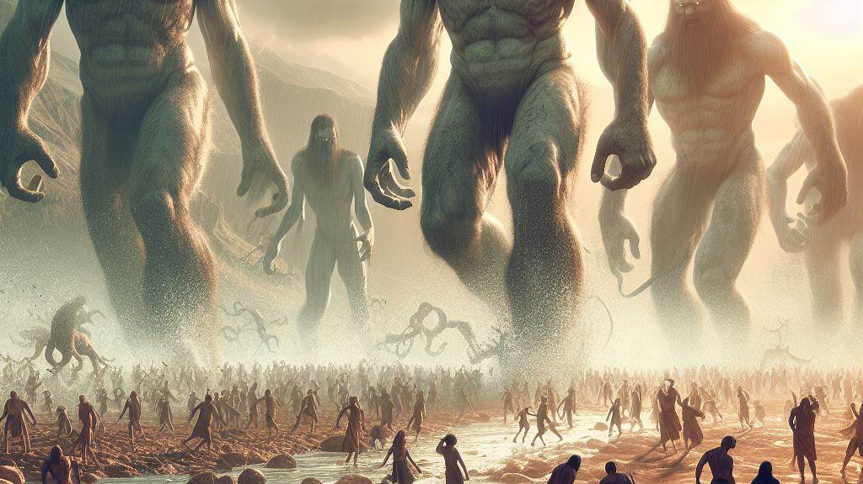
Pre-Flood Giants

Slide 2
How tall were the giants?

Slide 3
HOW TALL WERE THE GIANTS?
First Enoch 7:1-3
(RHCV, R.H. Charles Version)
And all the others together with them took unto themselves wives, and each chose for himself one, and they began to go in unto them and to defile themselves with them, and they taught them charms and enchantments, and the cutting of roots, and made them acquainted with plants. And they became pregnant, and they bare great giants, whose height was three thousand ells: Who consumed

Slide 4
HOW TALL WERE THE GIANTS?
Jubilees 29:9
(RHCV, R.H. Charles Version)
But before they used to call the land of Gilead the land of the Rephaim; for it was the land of the Rephaim, and the Rephaim were born (there), giants whose height was ten, nine, eight down to seven cubits.

Slide 5
Purpose for the Flood

Slide 6
The giants hurt mankind

Slide 7
The giants hurt mankind
First Enoch 10:15-16
(RHCV, R.H. Charles Version)
generations. And destroy all the spirits of the reprobate and the children of the Watchers, because they have wronged mankind. Destroy all wrong from the face of the earth and let every evil work come to an end: and let the plant of righteousness and truth appear: and it shall prove a blessing; the works of righteousness and truth' shall be planted in truth and joy for evermore.

Slide 8
The giants hurt mankind
Testament of Noah [1Q20, Column 6] 1:1
(RHCVKJ, R.H. Charles Translation, Edited by Ken Johnson, Th.D.)
After two weeks... bore witness to all the bloodshed by the Nephilim... I waited until... the daughters of men whom the holy ones made unclean by divination. I went and asked one of them...

Slide 9
The giants hurt mankind
Jubilees 7:22
(RHCV, R.H. Charles Version)
And they begat sons the Naphidim, and they were all unlike, and they devoured one another: and the Giants slew the Naphil, and the Naphil slew the Eljo, and the Eljo mankind, and one man another.

Slide 10
The giants hurt mankind
First Enoch 106:13-15
(RHCV, R.H. Charles Version)
And behold they commit sin and transgress the law, and have united themselves with women and commit sin with them, and have married some of them, and have begot children by them. And they shall produce on the earth giants not according to the spirit, but according to the flesh, and there shall be a great punishment on the earth, and the earth shall be cleansed from all impurity. (Continued...)

Slide 11
The giants hurt mankind
Yea, there shall come a great destruction over the whole earth, and there shall be a deluge and a great destruction for one year.

Slide 12
The giants hurt mankind
Genesis 6:11-12
(NASB, New American Standard Bible)
Now the earth was corrupt in the sight of God, and the earth was filled with violence. God looked on the earth, and behold, it was corrupt; for all flesh had corrupted their way upon the earth.

Slide 13
The giants hurt mankind
Jubilees 4:22-24
(RHCV, R.H. Charles Version)
And he testified to the Watchers, who had sinned with the daughters of men; for these had begun to unite themselves, so as to be defiled, with the daughters of men, and Enoch testified against (them) all. And he was taken from amongst the children of men, and we conducted him into the Garden of Eden in majesty and honour, and behold there he writes down the condemnation and judgment of the world, and all the wickedness of the children of men. (Continued...)

Slide 14
The giants hurt mankind
And on account of it (God) brought the waters of the flood upon all the land of Eden; for there he was set as a sign and that he should testify against all the children of men, that he should recount all the deeds of the generations until the day of condemnation.

Slide 15
The giants hurt mankind
Second Peter 2:4-5
(NASB, New American Standard Bible)
For if God did not spare angels when they sinned, but cast them into hell and committed them to pits of darkness, reserved for judgment; and did not spare the ancient world, but preserved Noah, a preacher of righteousness, with seven others, when He brought a flood upon the world of the ungodly;

Slide 16
The giants hurt mankind
Testament of Naphtali 3:3
(RHCVKJ, R.H. Charles Translation, Edited by Ken Johnson, Th.D.)
Do not become like Sodom, who changed the order of their nature in the same manner as the watchers changed the order of their nature. They are the cause of the flood and the desolation of the earth.

Slide 17
The giants hurt mankind
Jubilees 20:5
(RHCV, R.H. Charles Version)
And he told them of the judgment of the giants, and the judgment of the Sodomites, how they had been judged on account of their wickedness, and had died on account of their fornication, and uncleanness, and mutual corruption through fornication.

Slide 18
Spirits of dead giants remain on earth

Slide 19
SPIRITS OF DEAD GIANTS REMAIN ON EARTH
Antiquities of the Jews Book One 4:2
(Whiston Translation)
Now it was Nimrod who excited them to such an affront and contempt of God. He was the grandson of Ham, the son of Noah, a bold man, and of great strength of hand. He persuaded them not to ascribe it to God, as if it were through his means they were happy, but to believe that it was their own courage which procured that happiness. (Continued...)

Slide 20
SPIRITS OF DEAD GIANTS REMAIN ON EARTH
He also gradually changed the government into tyranny, seeing no other way of turning men from the fear of God, but to bring them into a constant dependence on his power. He also said he would be revenged on God, if he should have a mind to drown the world again; for that he would build a tower too high for the waters to reach. And that he would avenge himself on God for destroying their forefathers.

Slide 21
SPIRITS OF DEAD GIANTS REMAIN ON EARTH
First Enoch 15:8-12
(RHCV, R.H. Charles Version)
And now, the giants, who are produced from the spirits and flesh, shall be called evil spirits upon the earth, and on the earth shall be their dwelling. Evil spirits have proceeded from their bodies; because they are born from men and from the holy Watchers is their beginning and primal origin; they shall be evil spirits on earth, and evil spirits shall they be called. (Continued...)

Slide 22
SPIRITS OF DEAD GIANTS REMAIN ON EARTH
[As for the spirits of heaven, in heaven shall be their dwelling, but as for the spirits of the earth which were born upon the earth, on the earth shall be their dwelling.] And the spirits of the giants afflict, oppress, destroy, attack, do battle, and work destruction on the earth, and cause trouble: they take no food, but nevertheless hunger and thirst, and cause offences. (Continued...)

Slide 23
SPIRITS OF DEAD GIANTS REMAIN ON EARTH
And these spirits shall rise up against the children of men and against the women, because they have proceeded from them.

Slide 24
SPIRITS OF DEAD GIANTS REMAIN ON EARTH
First Enoch 16:1
(RHCV, R.H. Charles Version)
From the days of the slaughter and destruction and death of the giants, from the souls of whose flesh the spirits, having gone forth, shall destroy without incurring judgement -thus shall they destroy until the day of the consummation, the great judgement in which the age shall be

Slide 25
SPIRITS OF DEAD GIANTS REMAIN ON EARTH
First Enoch 19:1
(RHCV, R.H. Charles Version)
And Uriel said to me: 'Here shall stand the angels who have connected themselves with women, and their spirits assuming many different forms are defiling mankind and shall lead them astray into sacrificing to demons as gods, (here shall they stand,) till the day of the great judgement in

Slide 26
SPIRITS OF DEAD GIANTS REMAIN ON EARTH
Jubilees 10:1-14
(RHCV, R.H. Charles Version)
And in the third week of this jubilee the unclean demons began to lead astray the children of the sons of Noah, and to make to err and destroy them. And the sons of Noah came to Noah their father, and they told him concerning the demons which were leading astray and blinding and slaying his sons' sons. And he prayed before the Lord his God, and said: (Continued...)

Slide 27
SPIRITS OF DEAD GIANTS REMAIN ON EARTH
'God of the spirits of all flesh, who hast shown mercy unto me and hast saved me and my sons from the waters of the flood, And hast not caused me to perish as Thou didst the sons of perdition; For Thy grace has been great towards me, And great has been Thy mercy to my soul; Let Thy grace be lift up upon my sons, And let not wicked spirits rule over them lest they should destroy them from the earth. (Continued...)

Slide 28
SPIRITS OF DEAD GIANTS REMAIN ON EARTH
But do Thou bless me and my sons, that we may increase and Multiply and replenish the earth. And Thou knowest how Thy Watchers, the fathers of these spirits, acted in my day: and as for these spirits which are living, imprison them and hold them fast in the place of condemnation, and let them not bring destruction on the sons of thy servant, my God; for these are malignant, and created in order to destroy. And let them not rule over the spirits of the living; (Continued...)

Slide 29
SPIRITS OF DEAD GIANTS REMAIN ON EARTH
for Thou alone canst exercise dominion over them. And let them not have power over the sons of the righteous from henceforth and for evermore.' And the Lord our God bade us to bind all. And the chief of the spirits, Mastema, came and said: 'Lord, Creator, let some of them remain before me, and let them harken to my voice, and do all that I shall say unto them; for if some of them are not left to me, I shall not be able to execute the power of my will on the sons of men; (Continued...)

Slide 30
SPIRITS OF DEAD GIANTS REMAIN ON EARTH
for these are for corruption and leading astray before my judgment, for great is the wickedness of the sons of men.' And He said: Let the tenth part of them remain before him, and let nine parts descend into the place of condemnation.' And one of us He commanded that we should teach Noah all their medicines; for He knew that they would not walk in uprightness, nor strive in righteousness. And we did according to all His words: (Continued...)

Slide 31
SPIRITS OF DEAD GIANTS REMAIN ON EARTH
all the malignant evil ones we bound in the place of condemnation and a tenth part of them we left that they might be subject before Satan on the earth. And we explained to Noah all the medicines of their diseases, together with their seductions, how he might heal them with herbs of the earth. And Noah wrote down all things in a book as we instructed him concerning every kind of medicine. Thus the evil spirits were precluded from (hurting) the sons of Noah. (Continued...)

Slide 32
SPIRITS OF DEAD GIANTS REMAIN ON EARTH
And he gave all that he had written to Shem, his eldest son; for he loved him exceedingly above all his sons.

Slide 33
SPIRITS OF DEAD GIANTS REMAIN ON EARTH
Jubilees 10:5
(RHCV, R.H. Charles Version)
And Thou knowest how Thy Watchers, the fathers of these spirits, acted in my day: and as for these spirits which are living, imprison them and hold them fast in the place of condemnation, and let them not bring destruction on the sons of thy servant, my God; for these are malignant, and created in order to destroy.

Slide 34
SPIRITS OF DEAD GIANTS REMAIN ON EARTH
Testament of Reuben 5:1
(RHCVKJ, R.H. Charles Translation, Edited by Ken Johnson, Th.D.)
My children, ungodly women hurt you not by strength, but by subtle enticement. They hide who they really are and make you see what they want you to see. They cannot overcome you by strength, so they overcome you by craft. An Angel of God told me that fornication overcomes ungodly women more than men. They devised schemes to seduce men. They deceive the man's mind through their adornment and still poisoned by the glance of their eye, and capture him by their actions. (Continued...)

Slide 35
SPIRITS OF DEAD GIANTS REMAIN ON EARTH
Therefore, flee fortification, my children command your wives and daughters not to adorn their heads and faces. Because every woman who acts deceitfully in these things is destined for everlasting punishment. This is how they seduce the watchers before the flood. They appeared constantly in their presence this way until the watchers fell for them. They changed their form to that of men and came to the women. (Continued...)

Slide 36
SPIRITS OF DEAD GIANTS REMAIN ON EARTH
The ungodly women planned for this to happen because they desired heavenly husbands. Then they gave birth to Nephilim.

