Slide 1
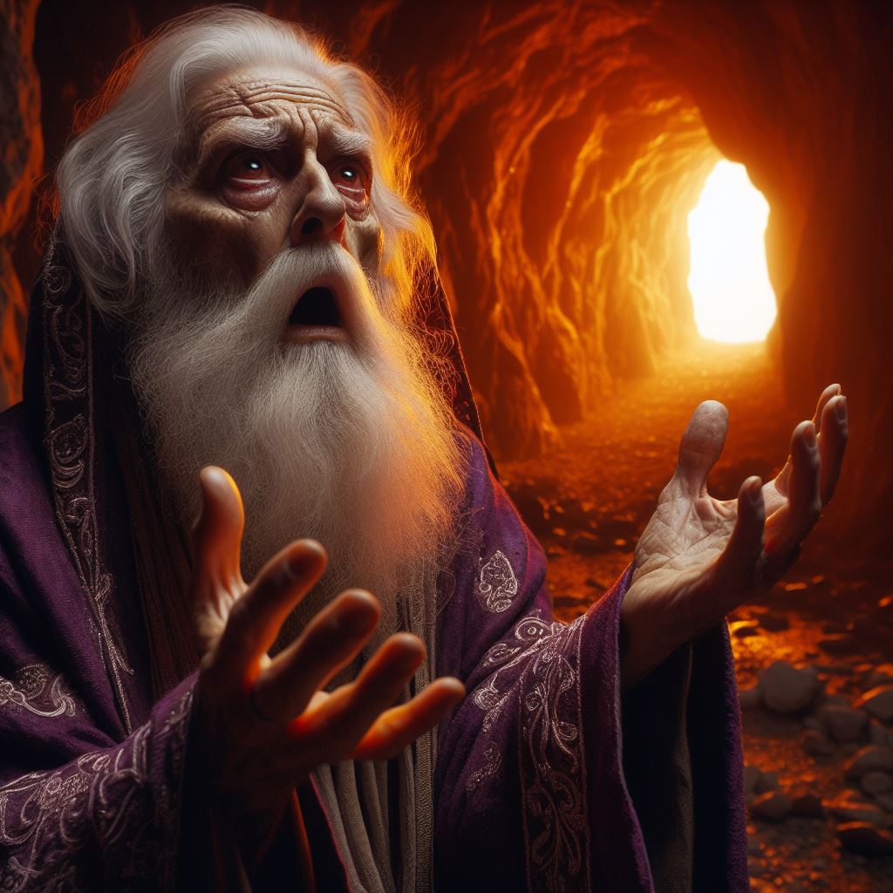
Sheol
“Hell”

Slide 2
What happens when we die?

Slide 3
WHAT HAPPENS WHEN WE DIE?
Daniel 12:2-3
(NASB, New American Standard Bible)
"Many of those who sleep in the dust of the ground will awake, these to everlasting life, but the others to disgrace and everlasting contempt. "Those who have insight will shine brightly like the brightness of the expanse of heaven, and those who lead the many to righteousness, like the stars forever and ever.

Slide 4
WHAT HAPPENS WHEN WE DIE?
First Enoch 91:10
(RHCV, R.H. Charles Version)
And the righteous shall arise from their sleep,

Slide 5
WHAT HAPPENS WHEN WE DIE?
Psalm 139:7-8
(NASB, New American Standard Bible)
Where can I go from Your Spirit? Or where can I flee from Your presence? If I ascend to heaven, You are there; If I make my bed in Sheol, behold, You are there.

Slide 6
WHAT HAPPENS WHEN WE DIE?
Second Baruch [Apocalypse of Baruch] 30:1-2
(CPR, Cepher (Modified))
And it shall be after these things when the time of the advent of the Anointed One is fulfilled and he returns with glory, Then all who have fallen asleep in hope of him shall arise again. (Continued...)

Slide 7
WHAT HAPPENS WHEN WE DIE?
And it shall come to pass at that time that the treasuries will be opened in which is preserved the number of the souls of the righteous, and they shall come forth, and a multitude of souls shall be seen together in one assemblage of one thought, and the first shall rejoice and the last shall not be grieved.

Slide 8
Where is Sheol?

Slide 9
WHERE IS SHEOL?
Amos 9:2
(NASB, New American Standard Bible)
"Though they dig into Sheol, From there will My hand take them; And though they ascend to heaven, From there will I bring them down.

Slide 10
WHERE IS SHEOL?
Psalm 71:20
(NASB, New American Standard Bible)
You who have shown me many troubles and distresses Will revive me again, And will bring me up again from the depths of the earth.

Slide 11
WHERE IS SHEOL?
Psalm 49:12-15
(NASB, New American Standard Bible)
But man in his pomp will not endure; He is like the beasts that perish. This is the way of those who are foolish, And of those after them who approve their words. Selah. As sheep they are appointed for Sheol; Death shall be their shepherd; And the upright shall rule over them in the morning, And their form shall be for Sheol to consume So that they have no habitation. But God will redeem my soul from the power of Sheol, For He will receive me. Selah.

Slide 12
WHERE IS SHEOL?
Jubilees 22:22
(RHCV, R.H. Charles Version)
And as for all the worshippers of idols and the profane There shall be no hope for them in the land of the living; And there shall be no remembrance of them on the earth; For they shall descend into Sheol, And into the place of condemnation shall they go, As the children of Sodom were taken away from the earth So will all those who worship idols be taken away.

Slide 13
WHERE IS SHEOL?
Jubilees 24:31
(RHCV, R.H. Charles Version)
For though he ascend unto heaven, Thence shall he be brought down, And though he make himself strong on earth, Thence shall he be dragged forth, And though he hide himself amongst the nations, Even from thence shall he be rooted out; And though he descend into Sheol, There also shall his condemnation be great, And there also he shall have no peace.

Slide 14
WHERE IS SHEOL?
Matthew 12:40
(NASB, New American Standard Bible)
for just as JONAH WAS THREE DAYS AND THREE NIGHTS IN THE BELLY OF THE SEA MONSTER, so will the Son of Man be three days and three nights in the heart of the earth.

Slide 15
What is Sheol like?

Slide 16
WHAT IS SHEOL LIKE?
First Enoch 22:1-6
(RHCV, R.H. Charles Version)
And thence I went to another place, and he mountain [and] of hard rock. And there was in it four hollow places, deep and wide and very smooth. How smooth are the hollow places and deep and dark to look at. Then Raphael answered, one of the holy angels who was with me, and said unto me: (Continued...)

Slide 17
WHAT IS SHEOL LIKE?
'These hollow places have been created for this very purpose, that the spirits of the souls of the dead should assemble therein, yea that all the souls of the children of men should assemble here. And these places have been made to receive them till the day of their judgement and till their appointed period [till the period appointed], till the great judgement (comes) upon them.' I saw (the spirit of) a dead man making suit, and his voice went forth to heaven and made suit. (Continued...)

Slide 18
WHAT IS SHEOL LIKE?
And I asked Raphael the angel who was with me, and I said unto him: 'This spirit which maketh suit, whose is it, whose voice goeth forth and maketh suit to heaven ?'

Slide 19
WHAT IS SHEOL LIKE?
Psalm 115:17
(NASB, New American Standard Bible)
The dead do not praise the LORD, Nor do any who go down into silence;

Slide 20
WHAT IS SHEOL LIKE?
Matthew 8:12
(NASB, New American Standard Bible)
but the sons of the kingdom will be cast out into the outer darkness; in that place there will be weeping and gnashing of teeth."

Slide 21
Both Righteous & Unrighteous go to Sheol

Slide 22
Unrighteous in Sheol

Slide 23
Unrighteous in Sheol
First Enoch 103:6-7
(RHCV, R.H. Charles Version)
And how they have died in prosperity and in wealth, Know ye, that their souls will be made to descend into Sheol

Slide 24
Unrighteous in Sheol
First Enoch 63:10
(RHCV, R.H. Charles Version)
Now they shall say unto themselves: ' Our souls are full of unrighteous gain, but it does not prevent us from descending from the midst thereof into the burden of Sheol.'

Slide 25
Righteous in Sheol

Slide 26
Righteous in Sheol
Job 14:13-15
(NASB, New American Standard Bible)
"Oh that You would hide me in Sheol, That You would conceal me until Your wrath returns to You, That You would set a limit for me and remember me! "If a man dies, will he live again? All the days of my struggle I will wait Until my change comes. "You will call, and I will answer You; You will long for the work of Your hands.

Slide 27
Righteous in Sheol
Second Esdras [4th Ezra] 7:88-101
(CPR, Cepher (Modified))
Now this is the order of those who have kept the ways of the Most High YHVH, when they shall be separated from their corruptible body. During the time that they decayed in it, they laboriously served the Most High, and withstood danger every hour, that they might keep the Torah of the Torah-giver perfectly. Therefore this is the teaching concerning them: (Continued...)

Slide 28
Righteous in Sheol
First of all, they shall see with great joy the splendor of HIM who receives them, for they shall have rest in seven orders. The first order, because they have striven with great effort to overcome evil which was formed 41with them, that it might not lead them astray from life into death. The second order, because they see the perplexity in which the souls of the wicked wander, and the punishment that waits them. (Continued...)

Slide 29
Righteous in Sheol
The third order, they see the witness which He who formed them bears concerning them, that while they were alive they kept the Torah which was given them in trust. The fourth order, they understand the rest which they now enjoy, being gathered into their chambers, and guarded by angels in profound quiet, and the splendor which awaits them in the last day. The fifth order, they rejoice that they have now escaped what is mortal, and shall inherit what is to come; (Continued...)

Slide 30
Righteous in Sheol
and besides they see the straits and the fullness of toil from which they have been delivered, and the spacious liberty which they are to receive and enjoy in immortality. The sixth order, when it is shown to them how their face is to shine like the sun, and how they are to be made like the light of the stars, being incorruptible from then on. (Continued...)

Slide 31
Righteous in Sheol
The seventh order, which is greater than all that have been mentioned, because they shall rejoice with boldness, and shall be confident without confusion, and shall be glad without fear, for they hasten to behold the face of HIM whom they served in life and from whom they are to receive their reward when magnified. (Continued...)

Slide 32
Righteous in Sheol
This is the order of the souls of the righteous, as henceforth is announced, and the aforesaid are the ways of torment which those who would not give heed shall suffer hereafter. I answered and said, Will time therefore be given to the souls after they have been separated from the bodies, to see what you have described to me? (Continued...)

Slide 33
Righteous in Sheol
He said to me, They shall have freedom for seven days, so that during these seven days they may see the things of which you have been told, and afterward they shall be gathered in their habitations.

Slide 34
Righteous in Sheol
Daniel 12:2
(NASB, New American Standard Bible)
"Many of those who sleep in the dust of the ground will awake, these to everlasting life, but the others to disgrace and everlasting contempt.

Slide 35
Righteous in Sheol
Hebrews 9:27-28
(NASB, New American Standard Bible)
And inasmuch as it is appointed for men to die once and after this comes judgment, so Christ also, having been offered once to bear the sins of many, will appear a second time for salvation without reference to sin, to those who eagerly await Him.

Slide 36
Righteous in Sheol
Luke 16:19-31
(NASB, New American Standard Bible)
"Now there was a rich man, and he habitually dressed in purple and fine linen, joyously living in splendor every day. "And a poor man named Lazarus was laid at his gate, covered with sores, and longing to be fed with the crumbs which were falling from the rich man's table; besides, even the dogs were coming and licking his sores. "Now the poor man died and was carried away by the angels to Abraham's bosom; and the rich man also died and was buried. (Continued...)

Slide 37
Righteous in Sheol
"In Hades he lifted up his eyes, being in torment, and saw Abraham far away and Lazarus in his bosom. "And he cried out and said, 'Father Abraham, have mercy on me, and send Lazarus so that he may dip the tip of his finger in water and cool off my tongue, for I am in agony in this flame.' "But Abraham said, 'Child, remember that during your life you received your good things, and likewise Lazarus bad things; but now he is being comforted here, and you are in agony. (Continued...)

Slide 38
Righteous in Sheol
And besides all this, between us and you there is a great chasm fixed, so that those who wish to come over from here to you will not be able, and that none may cross over from there to us.' "And he said, 'Then I beg you, father, that you send him to my father's house-- for I have five brothers--in order that he may warn them, so that they will not also come to this place of torment.' "But Abraham said, 'They have Moses and the Prophets; let them hear them. (Continued...)

Slide 39
Righteous in Sheol
' "But he said, 'No, father Abraham, but if someone goes to them from the dead, they will repent!' "But he said to him, 'If they do not listen to Moses and the Prophets, they will not be persuaded even if someone rises from the dead.'"

Slide 40
The Purpose of Sheol

Slide 41
THE PURPOSE OF SHEOL
Second Baruch [Apocalypse of Baruch] 50:2
(CPR, Cepher (Modified))
For the earth shall then assuredly restore the dead, which it now receives, in order to preserve them. It shall make no change in their form, but as it has received, so shall it restore them, and as I delivered them unto it, so also shall it raise them.

Slide 42
Did Enoch Die?

Slide 43
DID ENOCH DIE?
Genesis 5:24
(NASB, New American Standard Bible)
Enoch walked with God; and he was not, for God took him.

Slide 44
DID ENOCH DIE?
Hebrews 11:5-6
(NASB, New American Standard Bible)
By faith Enoch was taken up so that he would not see death; AND HE WAS NOT FOUND BECAUSE GOD TOOK HIM UP; for he obtained the witness that before his being taken up he was pleasing to God. And without faith it is impossible to please Him, for he who comes to God must believe that He is and that He is a rewarder of those who seek Him.

Slide 45
Death referred to as sleeping

Slide 46
DEATH REFERRED TO AS SLEEPING
Ephesians 5:14
(NASB, New American Standard Bible)
For this reason it says, "Awake, sleeper, And arise from the dead, And Christ will shine on you."

Slide 47
DEATH REFERRED TO AS SLEEPING
Shepherd of Hermas 13:1
(JBLT, J. B. Lightfoot Translation)
"Hear now concerning the stones that go to the building The stones that are squared and white, and that fit together in their joints, these are the apostles and bishops and teachers and deacons, who walked after the holiness of God, and exercised their office of bishop and teacher and deacon in purity and sanctity for the elect of God, some of them already fallen on sleep, and others still living. (Continued...)

Slide 48
DEATH REFERRED TO AS SLEEPING
And because they always agreed with one another, they both had peace among themselves and listened one to another. Therefore their joinings fit together in the building of the tower."

Slide 49
Burning forever?

Slide 50
BURNING FOREVER?
Shepherd of Hermas 7:2-3
(JBLT, J. B. Lightfoot Translation)
But herein is thy salvation, in that thou didst not depart from the living God, and in thy simplicity and thy great continence. These have saved thee, if thou abidest therein; and they save all who do such things, and walk in guilelessness and simplicity. These men prevail over all wickedness, and continue unto life eternal. Blessed are all they that work righteousness. They shall never be destroyed.

