Slide 1
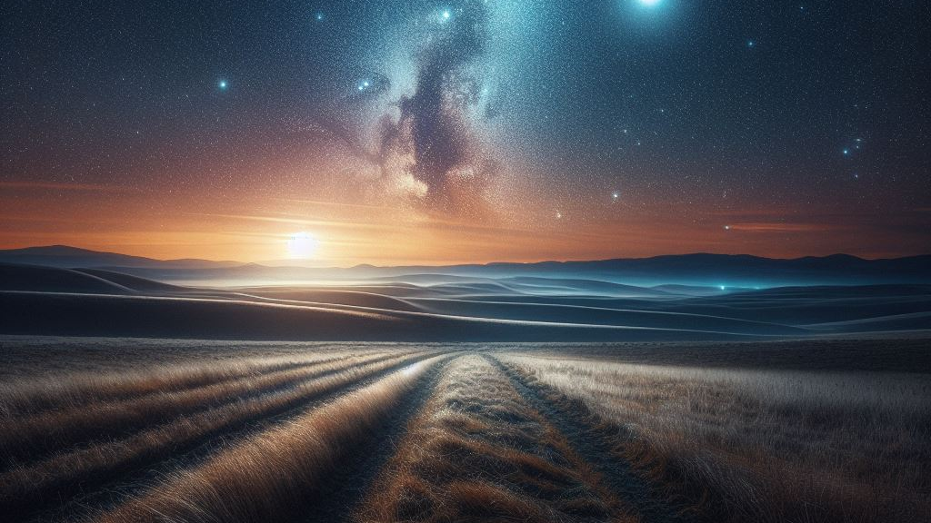
The Stars

Slide 2
The origin of stars

Slide 3
THE ORIGIN OF STARS
First Corinthians 8:5-6
(NASB, New American Standard Bible)
For even if there are so-called gods whether in heaven or on earth, as indeed there are many gods and many lords, yet for us there is but one God, the Father, from whom are all things and we exist for Him; and one Lord, Jesus Christ, by whom are all things, and we exist through Him.

Slide 4
THE ORIGIN OF STARS
Psalm 33:6
(NASB, New American Standard Bible)
By the word of the LORD the heavens were made, And by the breath of His mouth all their host.

Slide 5
People likened to stars

Slide 6
PEOPLE LIKENED TO STARS
Daniel 12:2-3
(NASB, New American Standard Bible)
"Many of those who sleep in the dust of the ground will awake, these to everlasting life, but the others to disgrace and everlasting contempt. "Those who have insight will shine brightly like the brightness of the expanse of heaven, and those who lead the many to righteousness, like the stars forever and ever.

Slide 7
PEOPLE LIKENED TO STARS
First Enoch 104:1-4
(RHCV, R.H. Charles Version)
I swear unto you, that in heaven the angels remember you for good before the glory of the Great One: and your names are written before the glory of the Great One. Be hopeful; for aforetime ye were put to shame through ill and affliction; but now ye shall shine as the lights of heaven, ye shall shine and ye shall be seen, and the portals of heaven shall be opened to you. And in your cry, cry for judgement, and it shall appear to you; (Continued...)

Slide 8
PEOPLE LIKENED TO STARS
for all your tribulation shall be visited on the rulers, and on all who helped those who plundered you. Be hopeful, and cast not away your hopes for ye shall have great joy as the angels of heaven.

Slide 9
PEOPLE LIKENED TO STARS
Second Baruch [Apocalypse of Baruch] 50:12
(CPR, Cepher (Modified))
For those who have departed in righteousness will be raised up and made equal to the stars and will be made to become like the angels in the place of the highest.

Slide 10
PEOPLE LIKENED TO STARS
Second Esdras [4th Ezra] 7:125
(NRSVUE, New Revised Standard Version Updated Edition)
And the faces of those who practice self-control shall shine brighter than the stars, but our faces shall be blacker than darkness.

Slide 11
PEOPLE LIKENED TO STARS
Assumption of Moses 10:9
(RHCV, R.H. Charles Version)
And God will exalt thee, And He will cause thee to approach to the heaven of the stars, And He will establish thy habitation among them. 10.And thou wilt look from on high and wilt see thy enemies in Ge(henna), And thou wilt recognize them and rejoice, And thou wilt give thanks and confess thy Creator.

Slide 12
Human-like characteristics of stars

Slide 13
Have names

Slide 14
Have names
First Enoch 33:3-4
(RHCV, R.H. Charles Version)
I counted the portals out of which they proceed, and wrote down all their outlets, of each individual star by itself, according to their number and their names, their courses and their positions, and their times and their months, as Uriel the holy angel who was with me showed me. He showed all things to me and wrote them down for me: also their names he wrote for me, and their laws and their companies.

Slide 15
Have names
Isaiah 40:26
(NASB, New American Standard Bible)
Lift up your eyes on high And see who has created these stars, The One who leads forth their host by number, He calls them all by name; Because of the greatness of His might and the strength of His power, Not one of them is missing.

Slide 16
Have names
Psalm 147:4
(NASB, New American Standard Bible)
He counts the number of the stars; He gives names to all of them.

Slide 17
Have names
Revelation 8:10-11
(NASB, New American Standard Bible)
The third angel sounded, and a great star fell from heaven, burning like a torch, and it fell on a third of the rivers and on the springs of waters. The name of the star is called Wormwood; and a third of the waters became wormwood, and many men died from the waters, because they were made bitter.

Slide 18
Ability to disobey

Slide 19
Ability to disobey
First Enoch 21:2-6
(RHCV, R.H. Charles Version)
And I saw there something horrible: I saw neither a heaven above nor a firmly founded earth, but a place chaotic and horrible. And there I saw seven stars of the heaven bound together in it, like great mountains and burning with fire. Then I said: 'For what sin are they bound, and on what account have they been cast in hither?' Then said Uriel, one of the holy angels, who was with me, and was chief over them, and said: (Continued...)

Slide 20
Ability to disobey
'Enoch, why dost thou ask, and why art thou eager for the truth? These are of the number of the stars of heaven, which have transgressed the commandment of the Lord, and are bound here till ten thousand years,

Slide 21
Ability to obey

Slide 22
Ability to obey
Sirach [Ecclesiasticus] 43:9-10
(RSV, Revised Standard Version)
The glory of the stars is the beauty of heaven, a gleaming array in the heights of the Lord. At the command of the Holy One they stand as ordered, they never relax in their watches.

Slide 23
Ability to obey
Matthew 2:7-10
(NASB, New American Standard Bible)
Then Herod secretly called the magi and determined from them the exact time the star appeared. And he sent them to Bethlehem and said, "Go and search carefully for the Child; and when you have found Him, report to me, so that I too may come and worship Him." After hearing the king, they went their way; and the star, which they had seen in the east, went on before them until it came and stood over the place where the Child was. (Continued...)

Slide 24
Ability to obey
When they saw the star, they rejoiced exceedingly with great joy.

Slide 25
Ability to obey
Revelation 9:1-2
(NASB, New American Standard Bible)
Then the fifth angel sounded, and I saw a star from heaven which had fallen to the earth; and the key of the bottomless pit was given to him. He opened the bottomless pit, and smoke went up out of the pit, like the smoke of a great furnace; and the sun and the air were darkened by the smoke of the pit.

Slide 26
May receive punishment

Slide 27
May receive punishment
First Enoch 23:4
(RHCV, R.H. Charles Version)
I asked saying: 'What is this which rests not?' Then Raguel, one of the holy angels who was with me, answered me and said unto me: 'This course of fire which thou hast seen is the fire in the west which persecutes all the luminaries of heaven.'

Slide 28
Ability of speech

Slide 29
Ability of speech
First Enoch 69:21
(RHCV, R.H. Charles Version)
And through that oath the stars complete their course,

Slide 30
Ability of speech
Job 38:3-7
(NASB, New American Standard Bible)
"Now gird up your loins like a man, And I will ask you, and you instruct Me! "Where were you when I laid the foundation of the earth? Tell Me, if you have understanding, Who set its measurements? Since you know. Or who stretched the line on it? "On what were its bases sunk? Or who laid its cornerstone, When the morning stars sang together And all the sons of God shouted for joy?

Slide 31
Ability of speech
Psalm 148:1-4
(NASB, New American Standard Bible)
Praise the LORD! Praise the LORD from the heavens; Praise Him in the heights! Praise Him, all His angels; Praise Him, all His hosts! Praise Him, sun and moon; Praise Him, all stars of light! Praise Him, highest heavens, And the waters that are above the heavens!

Slide 32
There are lots of stars

Slide 33
THERE ARE LOTS OF STARS
Deuteronomy 1:10
(NASB, New American Standard Bible)
The LORD your God has multiplied you, and behold, you are this day like the stars of heaven in number.

Slide 34
THERE ARE LOTS OF STARS
First Enoch 93:11
(RHCV, R.H. Charles Version)
[For who is there of all the children of men that is able to hear the voice of the Holy One without being troubled ? And who can think His thoughts ? and who is there that can behold all the works of heaven ? And how should there be one who could behold the heaven, and who is there that could understand the things of heaven and see a soul or a spirit and could tell thereof, or ascend and see all their ends and think them or do like them ? (Continued...)

Slide 35
THERE ARE LOTS OF STARS
And who is there of all men that could know what is the breadth and the length of the earth, and to whom has been shown the measure of all of them ? Or is there any one who could discern the length of the heaven and how great is its height, and upon what it is founded, and how great is the number of the stars, and where all the luminaries rest ?]

Slide 36
THERE ARE LOTS OF STARS
Genesis 15:5
(NASB, New American Standard Bible)
And He took him outside and said, "Now look toward the heavens, and count the stars, if you are able to count them." And He said to him, "So shall your descendants be."

Slide 37
THERE ARE LOTS OF STARS
Genesis 22:17
(NASB, New American Standard Bible)
indeed I will greatly bless you, and I will greatly multiply your seed as the stars of the heavens and as the sand which is on the seashore; and your seed shall possess the gate of their enemies.

Slide 38
THERE ARE LOTS OF STARS
Hebrews 11:12
(NASB, New American Standard Bible)
Therefore there was born even of one man, and him as good as dead at that, as many descendants AS THE STARS OF HEAVEN IN NUMBER, AND INNUMERABLE AS THE SAND WHICH IS BY THE SEASHORE.

Slide 39
Constellations

Slide 40
CONSTELLATIONS
Assumption of Moses 10:5
(RHCV, R.H. Charles Version)
And the horns of the sun will be broken and he will be turned into darkness; And the moon will not give her light, and be turned wholly into blood. And the circle of the stars will be disturbed.

Slide 41
CONSTELLATIONS
First Enoch 33:3-4
(RHCV, R.H. Charles Version)
I counted the portals out of which they proceed, and wrote down all their outlets, of each individual star by itself, according to their number and their names, their courses and their positions, and their times and their months, as Uriel the holy angel who was with me showed me. He showed all things to me and wrote them down for me: also their names he wrote for me, and their laws and their companies.

Slide 42
CONSTELLATIONS
First Enoch 43:1-4
(RHCV, R.H. Charles Version)
And I saw other lightnings and the stars of heaven, and I saw how He called them all by their names and they hearkened unto Him. And I saw how they are weighed in a righteous balance according to their proportions of light: (I saw) the width of their spaces and the day of their appearing, and how their revolution produces lightning: and (I saw) their revolution according to the number of the angels, and (how) they keep faith with each other. (Continued...)

Slide 43
CONSTELLATIONS
And I asked the angel who went with me who showed me what was hidden: 'What are these?' And he said to me: 'The Lord of Spirits hath showed thee their parabolic meaning (lit. 'their parable'): these are the names of the holy who dwell on the earth and believe in the name of the Lord of Spirits for ever and ever.'

Slide 44
CONSTELLATIONS
First Enoch 8:1-3
(RHCV, R.H. Charles Version)
And Azazel taught men to make swords, and knives, and shields, and breastplates, and made known to them the metals of the earth and the art of working them, and bracelets, and ornaments, and the use of antimony, and the beautifying of the eyelids, and all kinds of costly stones, and all colouring tinctures. And there arose much godlessness, and they committed fornication, and they were led astray, and became corrupt in all their ways. (Continued...)

Slide 45
CONSTELLATIONS
Semj z taught enchantments, and root-cuttings, 'Armaros the resolving of enchantments, Baraqijal (taught) astrology, Kokabel the constellations, Ezeqeel the knowledge of the clouds, Araqiel the signs of the earth, Shamsiel the signs of the sun, and Sariel the course of the moon. And as men perished, they cried, and their cry went up to heaven . . .

