Slide 1
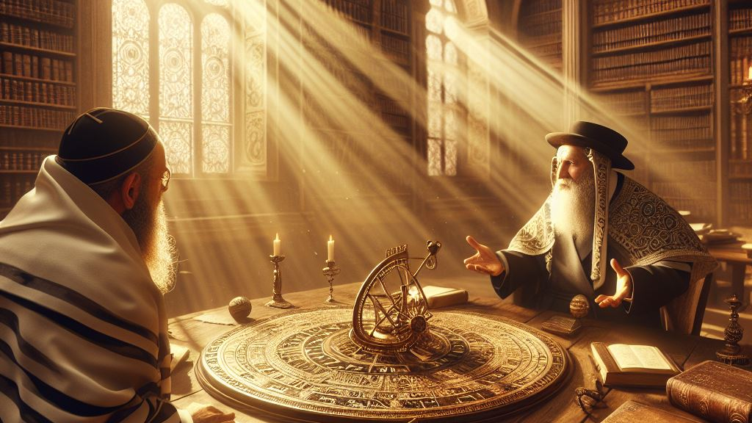
The Calendar Argument

Slide 2
Has the calendar ever changed?

Slide 3
Times never change

Slide 4
Times never change
First Enoch 72:1
(RHCV, R.H. Charles Version)
The book of the courses of the luminaries of the heaven, the relations of each, according to their classes, their dominion and their seasons, according to their names and places of origin, and according to their months, which Uriel, the holy angel, who was with me, who is their guide, showed me; and he showed me all their laws exactly as they are, and how it is with regard to all the years of the world

Slide 5
Times never change
Genesis 8:22
(NASB, New American Standard Bible)
"While the earth remains, Seedtime and harvest, And cold and heat, And summer and winter, And day and night Shall not cease."

Slide 6
Times never change
Jeremiah 31:35-37
(NASB, New American Standard Bible)
Thus says the LORD, Who gives the sun for light by day And the fixed order of the moon and the stars for light by night, Who stirs up the sea so that its waves roar; The LORD of hosts is His name: "If this fixed order departs From before Me," declares the LORD, "Then the offspring of Israel also will cease From being a nation before Me forever. (Continued...)

Slide 7
Times never change
" Thus says the LORD, "If the heavens above can be measured And the foundations of the earth searched out below, Then I will also cast off all the offspring of Israel For all that they have done," declares the LORD.

Slide 8
Times never change
Jeremiah 33:25-26
(NASB, New American Standard Bible)
"Thus says the LORD, 'If My covenant for day and night stand not, and the fixed patterns of heaven and earth I have not established, then I would reject the descendants of Jacob and David My servant, not taking from his descendants rulers over the descendants of Abraham, Isaac and Jacob. But I will restore their fortunes and will have mercy on them.'"

Slide 9
Times never change
Jubilees 6:4
(RHCV, R.H. Charles Version)
And the Lord smelt the goodly savour, and He made a covenant with him that there should not be any more a flood to destroy the earth; that all the days of the earth seed-time and harvest should never cease; cold and heat, and summer and winter, and day and night should not change their order, nor cease for ever.

Slide 10
Times never change
Second Esdras [4th Ezra] 4:37
(1611 KJV, King James Version)
By measure hath he measured the times; and by number hath he numbered the times; and he doth not move nor stir them, until the said measure be fulfilled.

Slide 11
Evil ones will alter the calendar

Slide 12
Evil ones will alter the calendar
Daniel 7:25
(NASB, New American Standard Bible)
He will speak out against the Most High and wear down the saints of the Highest One, and he will intend to make alterations in times and in law; and they will be given into his hand for a time, times, and half a time.

Slide 13
The Calendar will be lost/forgotten

Slide 14
THE CALENDAR WILL BE LOST/FORGOTTEN
Jubilees 6:32-38
(RHCV, R.H. Charles Version)
And command thou the children of Israel that they observe the years according to this reckoning- three hundred and sixty-four days, and (these) will constitute a complete year, and they will not disturb its time from its days and from its feasts; for everything will fall out in them according to their testimony, and they will not leave out any day nor disturb any feasts. (Continued...)

Slide 15
THE CALENDAR WILL BE LOST/FORGOTTEN
But if they do neglect and do not observe them according to His commandment, then they will disturb all their seasons and the years will be dislodged from this (order), [and they will disturb the seasons and the years will be dislodged] and they will neglect their ordinances. And all the children of Israel will forget and will not find the path of the years, and will forget the new moons, and seasons, and sabbaths and they will go wrong as to all the order of the years. (Continued...)

Slide 16
THE CALENDAR WILL BE LOST/FORGOTTEN
For I know and from henceforth will I declare it unto thee, and it is not of my own devising; for the book (lies) written before me, and on the heavenly tablets the division of days is ordained, lest they forget the feasts of the covenant and walk according to the feasts of the Gentiles after their error and after their ignorance. (Continued...)

Slide 17
THE CALENDAR WILL BE LOST/FORGOTTEN
For there will be those who will assuredly make observations of the moon -how (it) disturbs the seasons and comes in from year to year ten days too soon. For this reason the years will come upon them when they will disturb (the order), and make an abominable (day) the day of testimony, and an unclean day a feast day, and they will confound all the days, the holy with the unclean, and the unclean day with the holy; (Continued...)

Slide 18
THE CALENDAR WILL BE LOST/FORGOTTEN
for they will go wrong as to the months and sabbaths and feasts and jubilees. For this reason I command and testify to thee that thou mayst testify to them; for after thy death thy children will disturb (them), so that they will not make the year three hundred and sixty-four days only, and for this reason they will go wrong as to the new moons and seasons and sabbaths and festivals, and they will eat all kinds of blood with all kinds of flesh.

Slide 19
THE CALENDAR WILL BE LOST/FORGOTTEN
Matthew 24:36
(NASB, New American Standard Bible)
"But of that day and hour no one knows, not even the angels of heaven, nor the Son, but the Father alone.

Slide 20
THE CALENDAR WILL BE LOST/FORGOTTEN
Lamentations 2:5-7
(NASB, New American Standard Bible)
The Lord has become like an enemy. He has swallowed up Israel; He has swallowed up all its palaces, He has destroyed its strongholds And multiplied in the daughter of Judah Mourning and moaning. And He has violently treated His tabernacle like a garden booth; He has destroyed His appointed meeting place. The LORD has caused to be forgotten The appointed feast and sabbath in Zion, And He has despised king and priest In the indignation of His anger. (Continued...)

Slide 21
THE CALENDAR WILL BE LOST/FORGOTTEN
The Lord has rejected His altar, He has abandoned His sanctuary; He has delivered into the hand of the enemy The walls of her palaces. They have made a noise in the house of the LORD As in the day of an appointed feast.

Slide 22
THE CALENDAR WILL BE LOST/FORGOTTEN
Jubilees 1:13
(RHCV, R.H. Charles Version)
And they will forget all My law and all My commandments and all My judgments, and will go astray as to new moons, and sabbaths, and festivals, and jubilees, and ordinances.

Slide 23
THE CALENDAR WILL BE LOST/FORGOTTEN
Jubilees 50:1
(RHCV, R.H. Charles Version)
And after this law I made known to thee the days of the Sabbaths in the desert of Sin[ai], which is between Elim and Sinai.

Slide 24
THE CALENDAR WILL BE LOST/FORGOTTEN
Mark 2:18
(NASB, New American Standard Bible)
John's disciples and the Pharisees were fasting; and they came and said to Him, "Why do John's disciples and the disciples of the Pharisees fast, but Your disciples do not fast?"

Slide 25
THE CALENDAR WILL BE LOST/FORGOTTEN
Romans 14:5-9
(NASB, New American Standard Bible)
One person regards one day above another, another regards every day alike. Each person must be fully convinced in his own mind. He who observes the day, observes it for the Lord, and he who eats, does so for the Lord, for he gives thanks to God; and he who eats not, for the Lord he does not eat, and gives thanks to God. For not one of us lives for himself, and not one dies for himself; for if we live, we live for the Lord, or if we die, we die for the Lord; (Continued...)

Slide 26
THE CALENDAR WILL BE LOST/FORGOTTEN
therefore whether we live or die, we are the Lord's. For to this end Christ died and lived again, that He might be Lord both of the dead and of the living.

Slide 27
THE CALENDAR WILL BE LOST/FORGOTTEN
Daniel 2:21
(NASB, New American Standard Bible)
"It is He who changes the times and the epochs; He removes kings and establishes kings; He gives wisdom to wise men And knowledge to men of understanding.

Slide 28
THE CALENDAR WILL BE LOST/FORGOTTEN
Psalm 90:12
(NASB, New American Standard Bible)
So teach us to number our days, That we may present to You a heart of wisdom.

Slide 29
THE CALENDAR WILL BE LOST/FORGOTTEN
Acts 1:7
(ASV, American Standard Version)
And he said unto them, It is not for you to know times or seasons, which the Father hath set within His own authority.

Slide 30
Multiple Calendars & Practices in Yeshua's Day

Slide 31
MULTIPLE CALENDARS & PRACTICES IN YESHUA'S DAY
Mark 2:18-20
(ASV, American Standard Version)
And John's disciples and the Pharisees were fasting: and they come and say unto him, Why do John's disciples and the disciples of the Pharisees fast, but thy disciples fast not? And Jesus said unto them, Can the sons of the bridechamber fast, while the bridegroom is with them? as long as they have the bridegroom with them, they cannot fast. But the days will come, when the bridegroom shall be taken away from them, and then will they fast in that day.

Slide 32
The errors of the Hillel Calendar

Slide 33
Rosh Hashanah

Slide 34
Rosh Hashanah
Exodus 12:1-3
(NASB, New American Standard Bible)
Now the LORD said to Moses and Aaron in the land of Egypt, "This month shall be the beginning of months for you; it is to be the first month of the year to you. "Speak to all the congregation of Israel, saying, 'On the tenth of this month they are each one to take a lamb for themselves, according to their fathers' households, a lamb for each household.

Slide 35
Rosh Hashanah
Leviticus 23:24
(NASB, New American Standard Bible)
"Speak to the sons of Israel, saying, 'In the seventh month on the first of the month you shall have a rest, a reminder by blowing of trumpets, a holy convocation.

Slide 36
The Months

Slide 37
The Months
Exodus 23:13
(NASB, New American Standard Bible)
"Now concerning everything which I have said to you, be on your guard; and do not mention the name of other gods, nor let them be heard from your mouth.

Slide 38
The Months
First Kings 6:38
(NASB, New American Standard Bible)
In the eleventh year, in the month of Bul, which is the eighth month, the house was finished throughout all its parts and according to all its plans. So he was seven years in building it.

